Slide 1
Safar.com
JOURNEYS AS GREAT AS THE DESTINATIONS

Slide 2
TEAM INFORMATION
TEAM MEMBERS:
CHANDRADIPA NAG (TEAM LEADER)-
Database Design, Front-End Flow, Angular Forms, Angular Services, Functionalities Validation,
Front-End Integration with Back-End, Front-End Designing,
Back-End implementation using Spring Boot
SAPTARSHI HALDER-
Database Design, Angular Forms, Form Validations in Front-End, Front-End Designing
Back-End implementation using Spring Boot, Email Sending, Back-End Functionalities Validation
SUBHODIP CHATTERJEE-
Home-Page, Contact-Us, About-Us page using HTML and CSS
APARAJITA SRIVASTAVA-
Database Design, About-Us page using HTML and CSS, Adding background images, Font Styling

Slide 3
PROBLEM STATEMENT
Safar is a user-based project in the 'Tours and Travel' domain, specially made keeping in mind to deliver an uncomplicated experience to a user for bus ticket booking. Providing users with scores of exclusive facilities and features, from booking a bus ticket to booking an entire bus, Safar is aimed at hashing out a sleek user interface coupled with a seamless experience that is bound to leave a lasting impact on the user.

Slide 4
OBJECTIVES
To ensure an effortless and user-friendly bus booking experience
To provide booking facilities for both Registered and Un-Registered users
To provide users with premier features such as the likes of hiring an entire bus for themselves or cancelling a ticket seamlessly and many more
Book online using credit, debit cards and net banking
Paperless bus ticketing

Slide 5
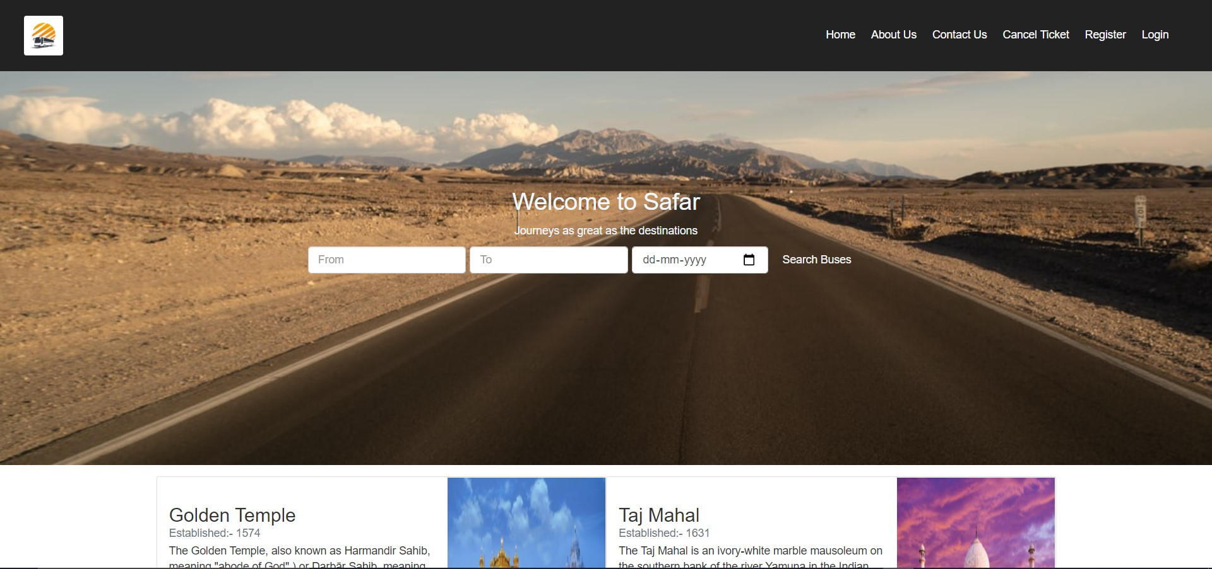
GLIMPSE OF THE PROJECT

Slide 6
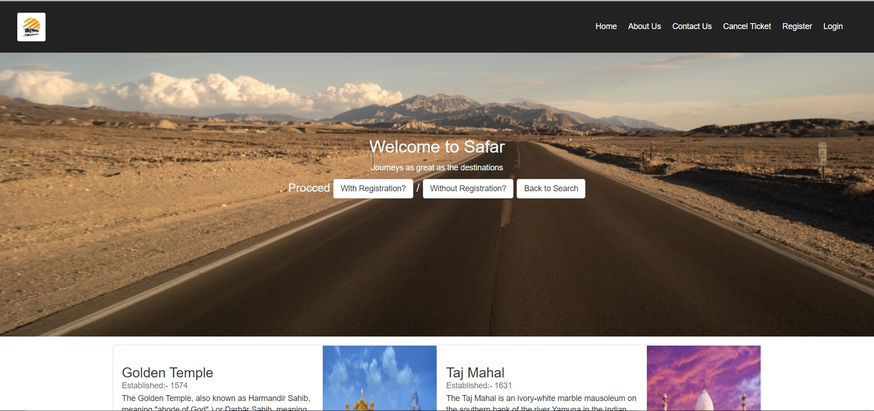
GLIMPSE OF THE PROJECT

Slide 7
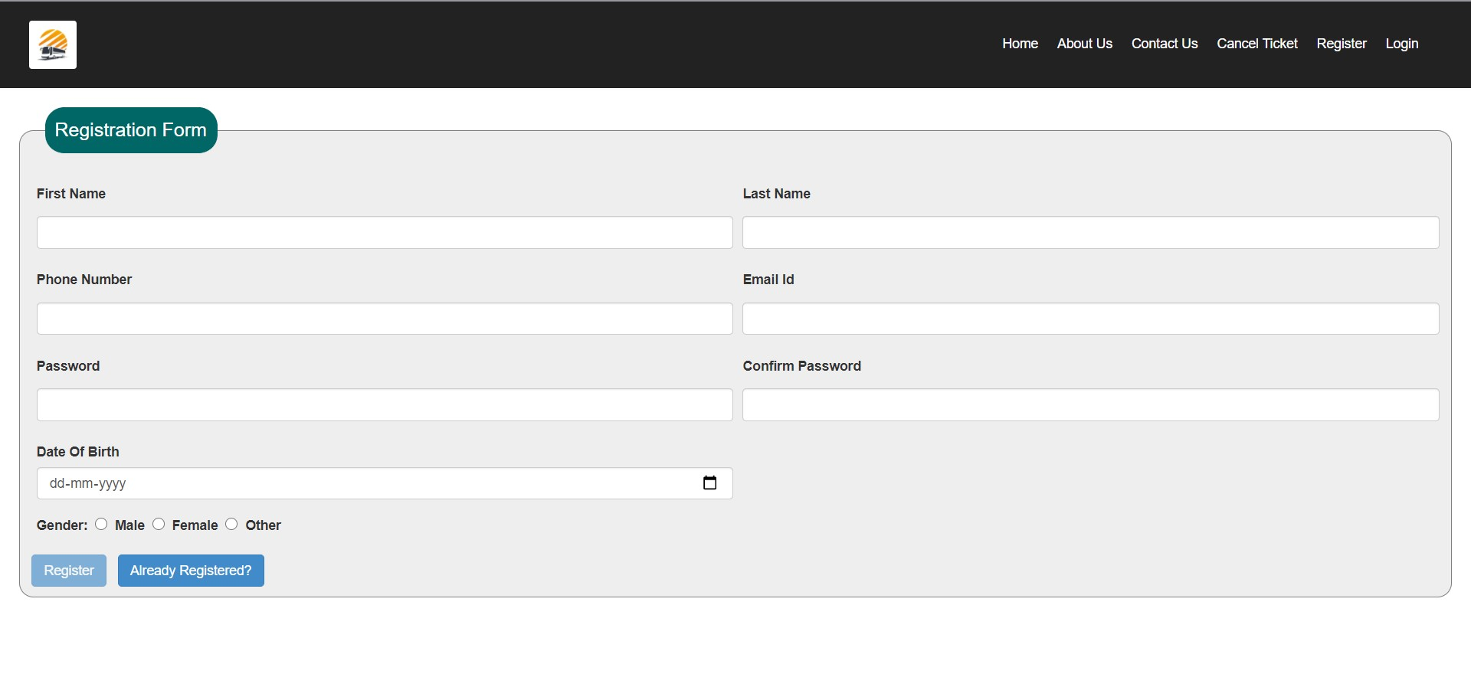
GLIMPSE OF THE PROJECT

Slide 8
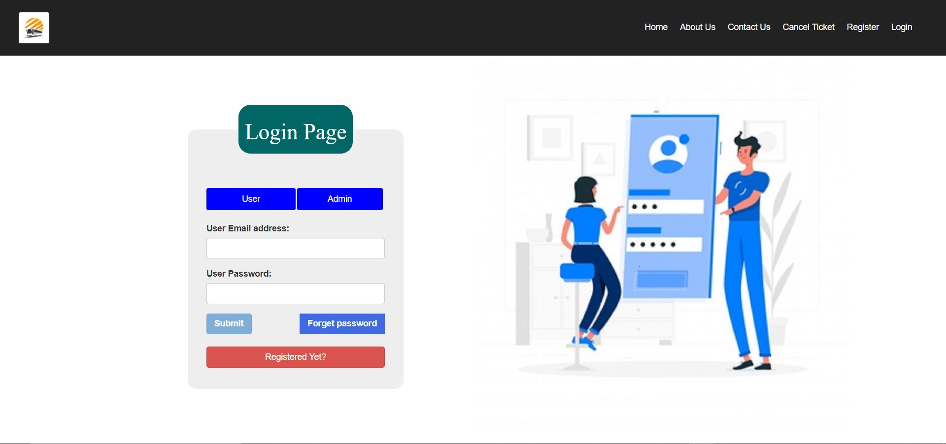
GLIMPSE OF THE PROJECT

Slide 9
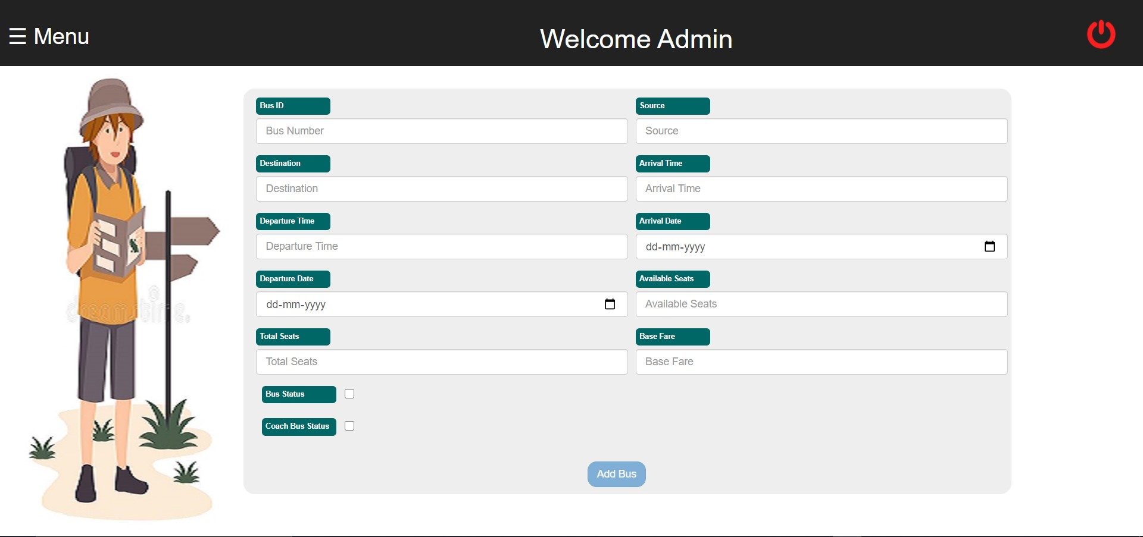
GLIMPSE OF THE PROJECT

Slide 10
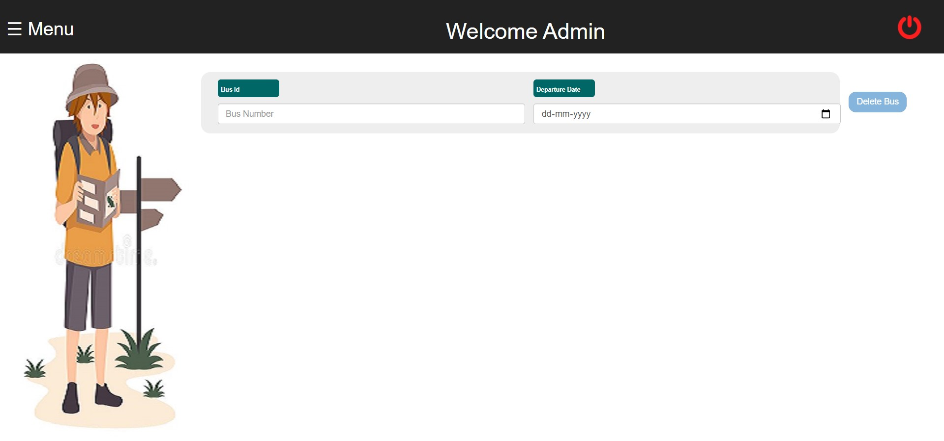
GLIMPSE OF THE PROJECT

Slide 11
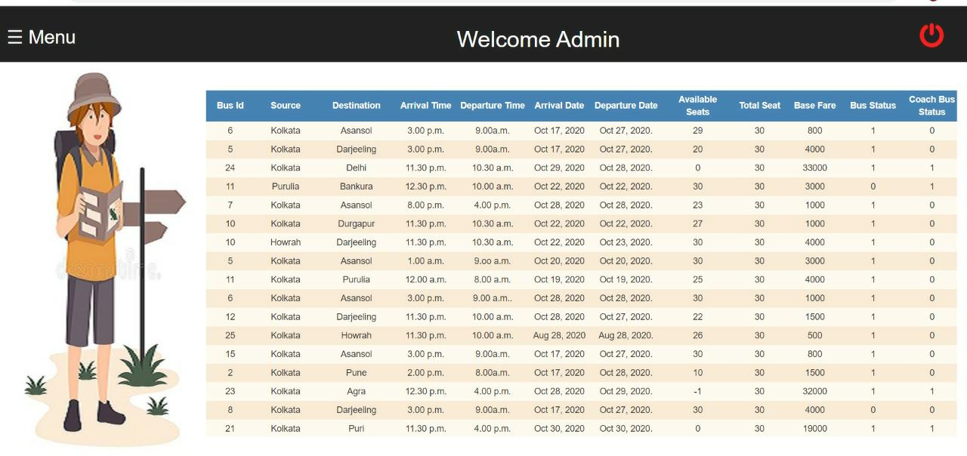
GLIMPSE OF THE PROJECT

Slide 12
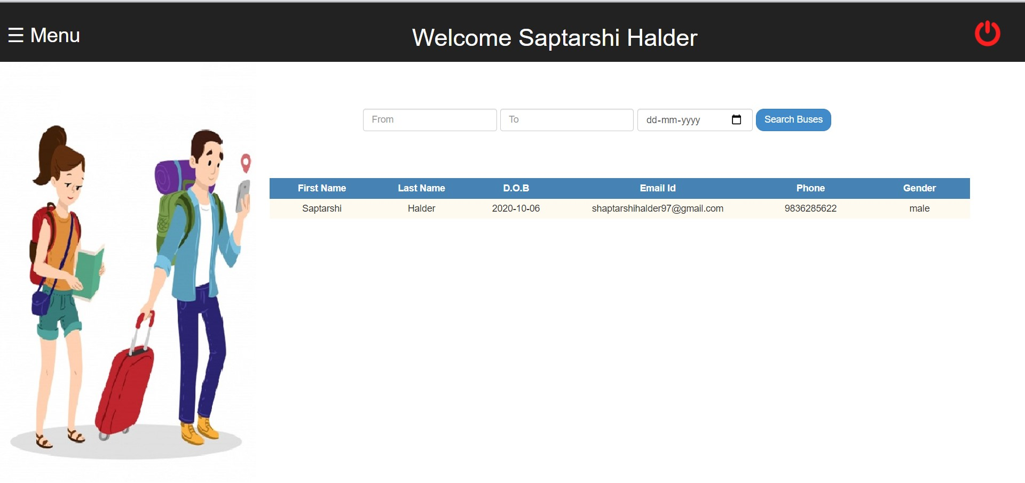
GLIMPSE OF THE PROJECT

Slide 13
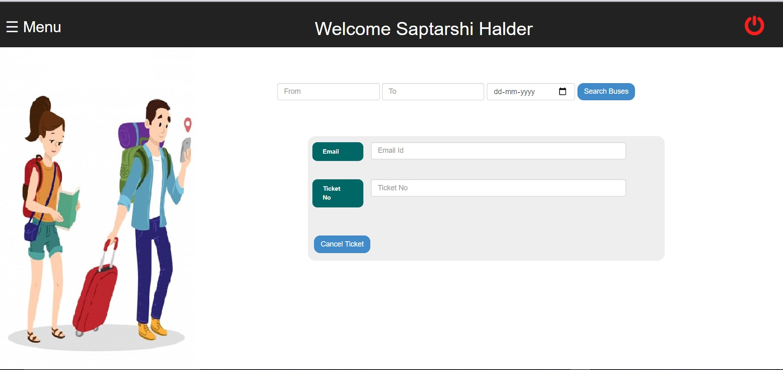
GLIMPSE OF THE PROJECT

Slide 14
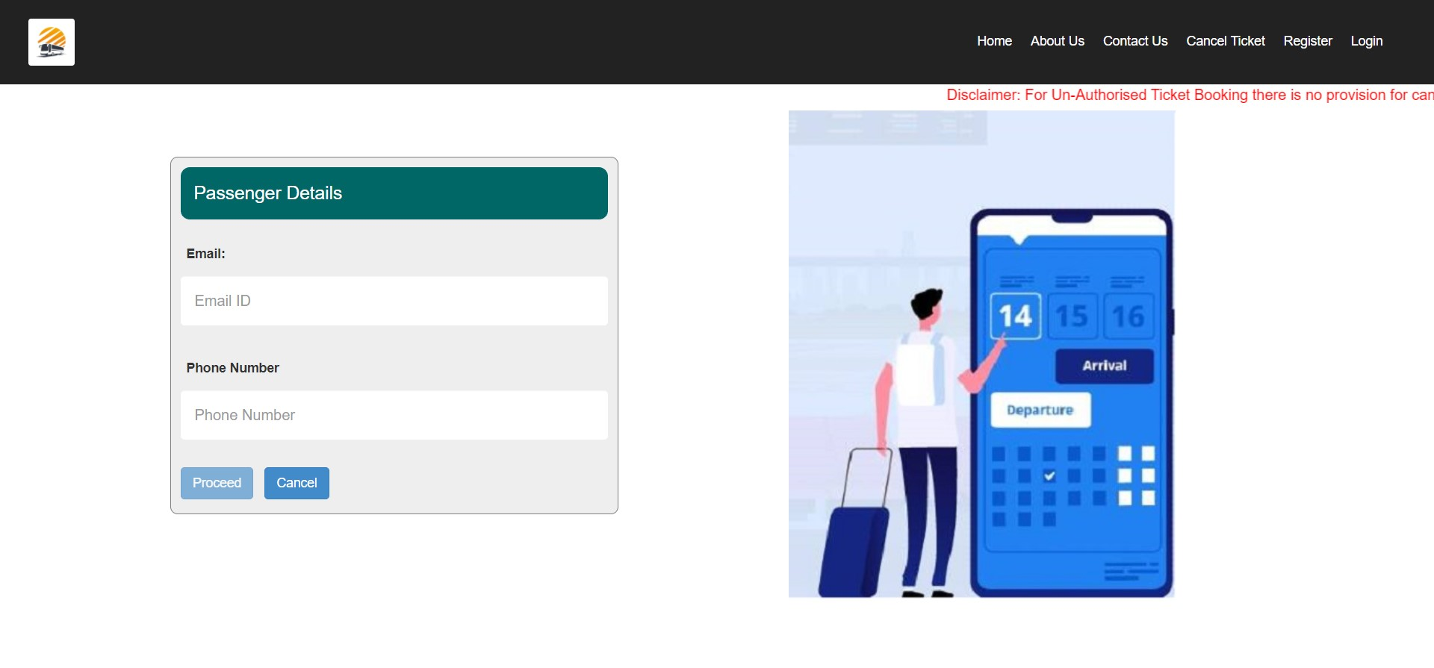
GLIMPSE OF THE PROJECT

Slide 15
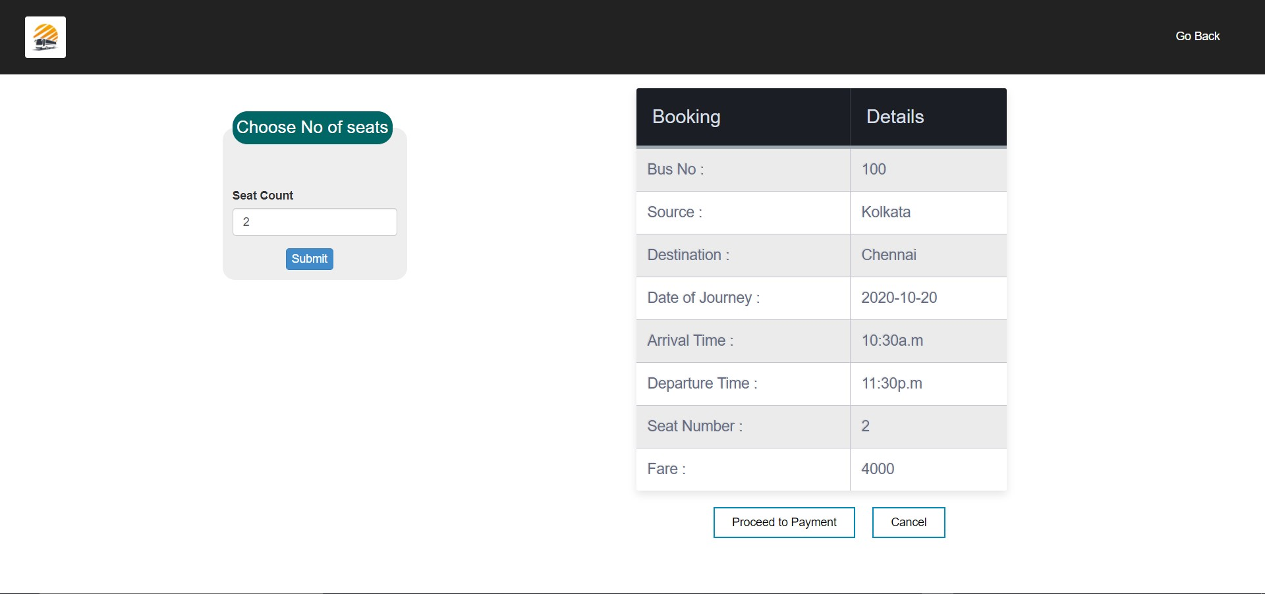
GLIMPSE OF THE PROJECT

Slide 16
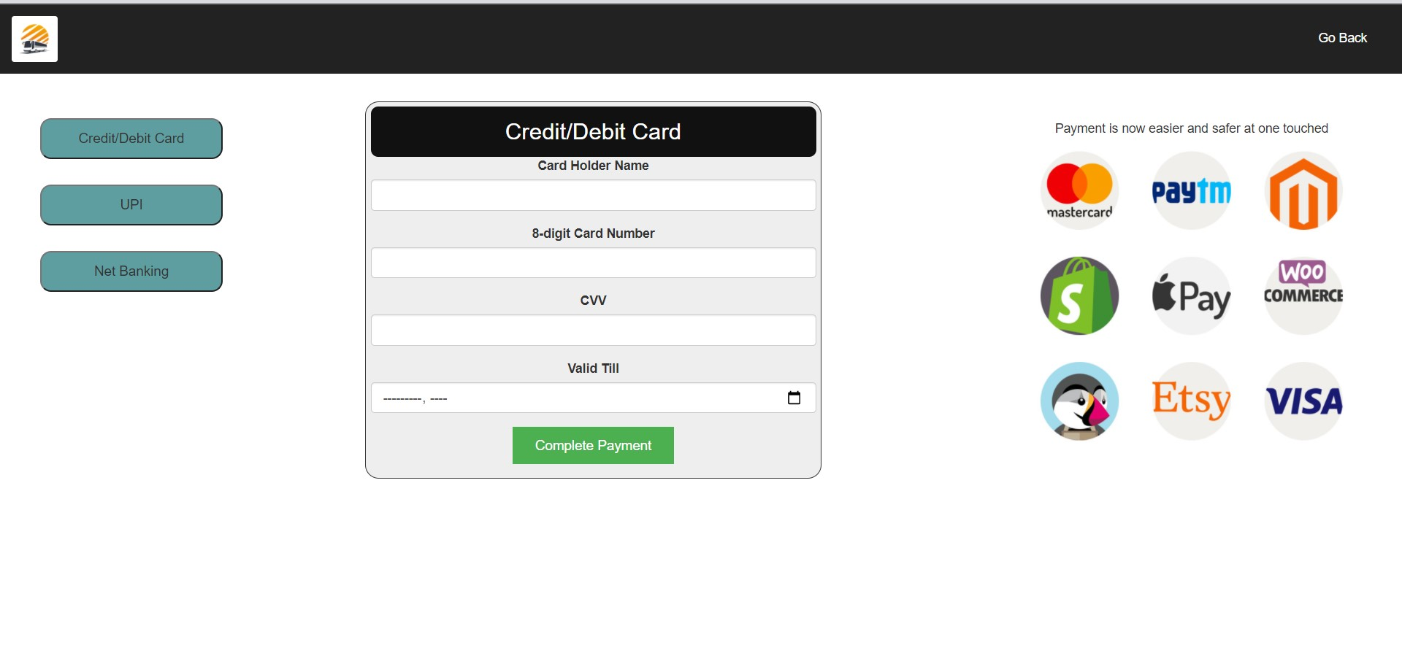
GLIMPSE OF THE PROJECT

Slide 17
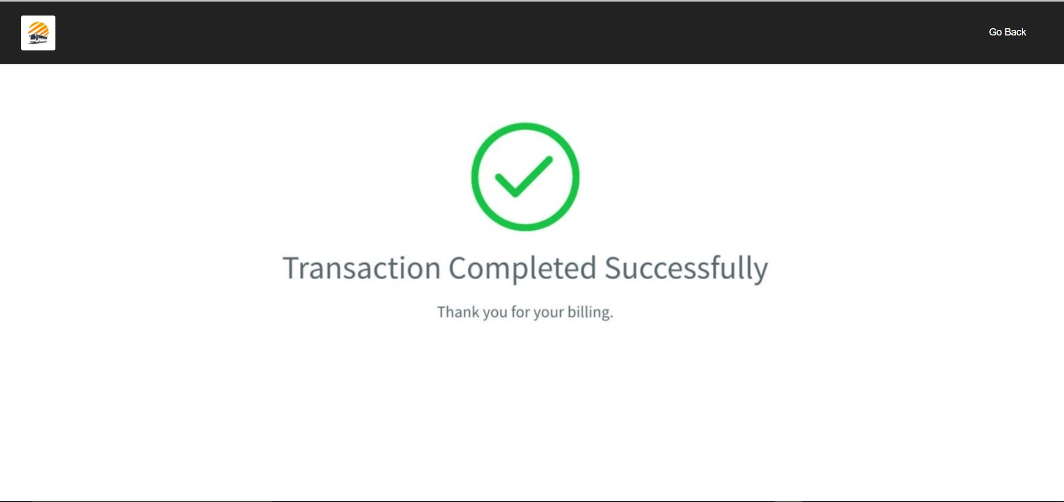
GLIMPSE OF THE PROJECT

Slide 18
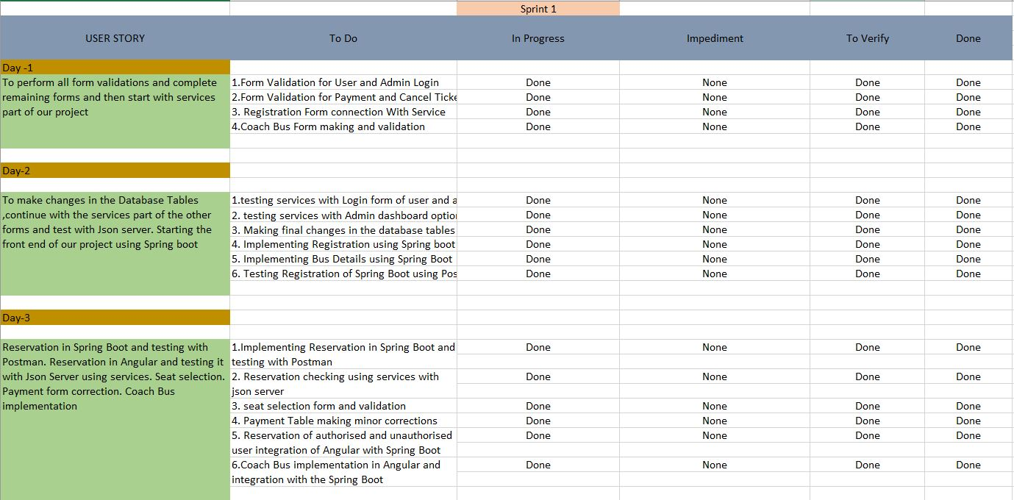
SCRUM TABLE

Slide 19
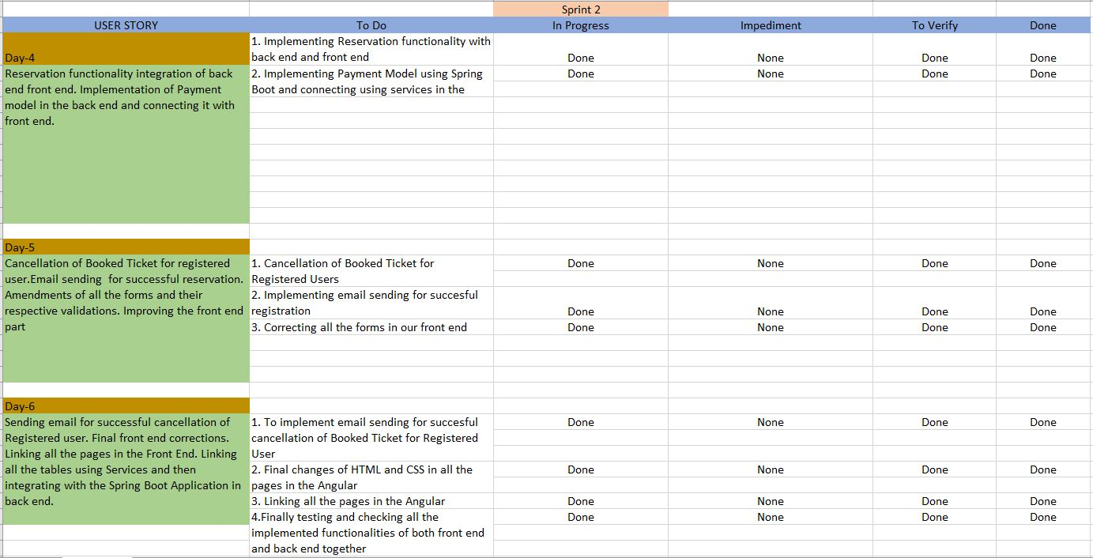
SCRUM TABLE

Slide 20
CONCLUSION
The project will entitle a user to a harmonious experience of booking bus tickets without moving a limb. With facets aimed at prioritising the customer's needs and comfort, it would make an otherwise troublesome procedure of procuring bus tickets a very leisure one. We are passionate about creating amazing experiences for passengers.

